Slide 1
Introduction to Rivanna

Slide 2




Rivanna
Rivanna is the university's primary resource for high-performance computation for non-sensitive data. It provides a platform for computationally-intensive research across disciplines.

Slide 3
Terminology
Node
Basic building block of a cluster
Usually a specialized computer
Two types of nodes:
Head Node – computer used for logging on and submitting jobs
Compute Node -- computer that does most of the work
Core – an individual processor on a computer

Slide 4


Rivanna in More Detail
Compute Nodes
Head Nodes
Access from your computer
Ethernet
Home Directory
Other Storage
Scratch
(Lustre)
Infiniband

Slide 5

Before we can use the Cluster . . .
We need to know about:
Allocations & Accounts
Connections to the cluster
Cluster environment
Modules & Partitions
SLURM & Job Submissions
The remaining slides will cover
the basics of these topics.

Slide 6
Allocations

Slide 7
Allocations
Rivanna is allocated:
At the most basic level, an allocation refers to a chunk of CPU time that you can use to run your computations.
Only faculty, postdocs, and research staff may request an allocation.
Students must be sponsored by a faculty or research staff.
All individuals on a given allocation share the service units.
Allocations may be requested at
https://www.rc.virginia.edu/userinfo/rivanna/allocations/
Allocations are measured in service units (SUs), where 1 SU = 1 core-hour

Slide 8




Getting an account on Rivanna
Request an Allocation
Receive Allocation and Account(s)
Research Computing
Allows access
Principle Investigator (PI)
Researchers

Slide 9
Connecting & Logging Onto Rivanna

Slide 10
If You are Off-Grounds . . .
You may need to use the UVa Anywhere VPN when connecting to Rivanna
To install the VPN on your computer, go to https://in.virginia.edu/vpn and follow the instructions.
During the COVID-19 outbreak, we are asking users to connect with the “UVa More Secure” VPN.
Follow the same installation instructions. When launching the VPN, select “More Secure” from the dropdown box.

Slide 11
How to connect to Rivanna
There are three ways to connect to Rivanna:
Connecting to a graphical user interface through a web browser (Open OnDemand)
examine and manipulate files and submit jobs.
access applications such as FastX, Jupyterlab, and R Studio Server.
Direct Access through FastX Web
https://rivanna-desktop.hpc.virginia.edu
ssh (secure shell)
Connecting with an ssh client requires a terminal window (i.e., shell)

Slide 12
Connecting to Open OnDemand
To connect to Open OnDemand, open your web browser and type
https://rivanna-portal.hpc.virginia.edu
You will need to authenticate with Netbadge (i.e., “Netbadge in”).
After you log in, you will see the Dashboard.

Slide 13
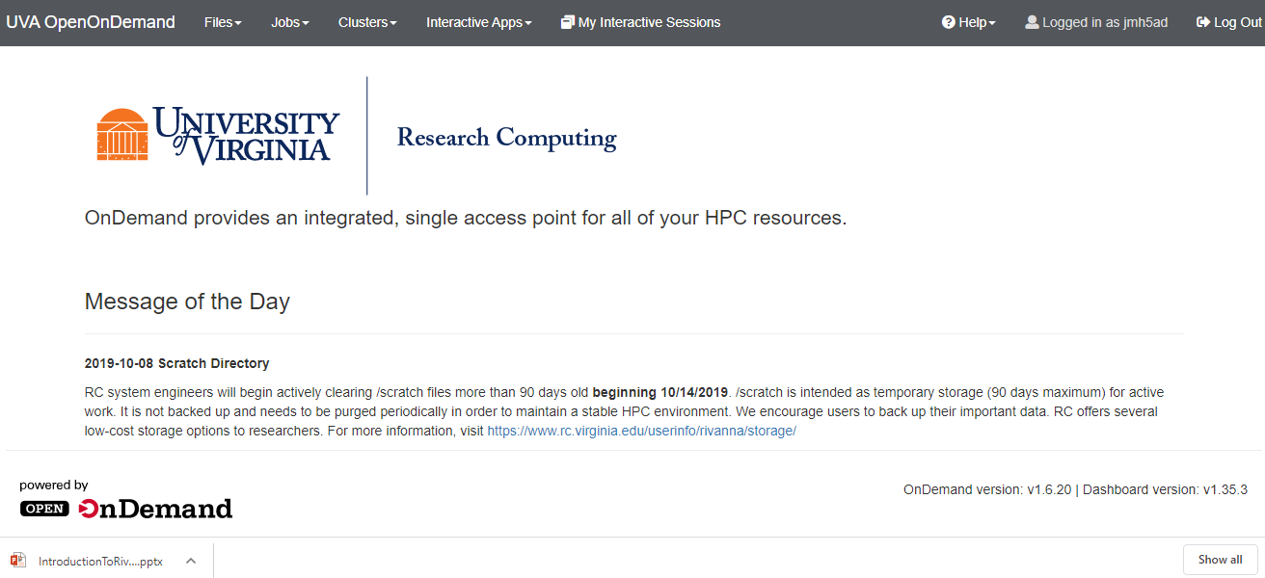
Open onDemand Dashboard

Slide 14
Open onDemand Dashboard

Slide 15
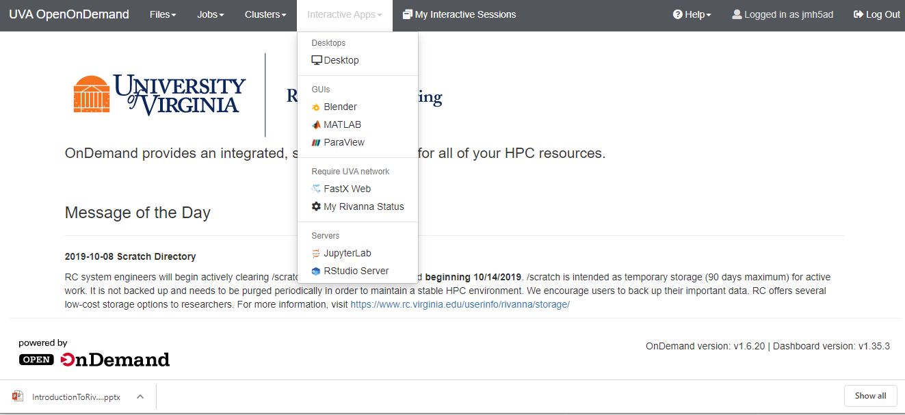
Interactive Apps
Let’s try FastX for now.

Slide 16
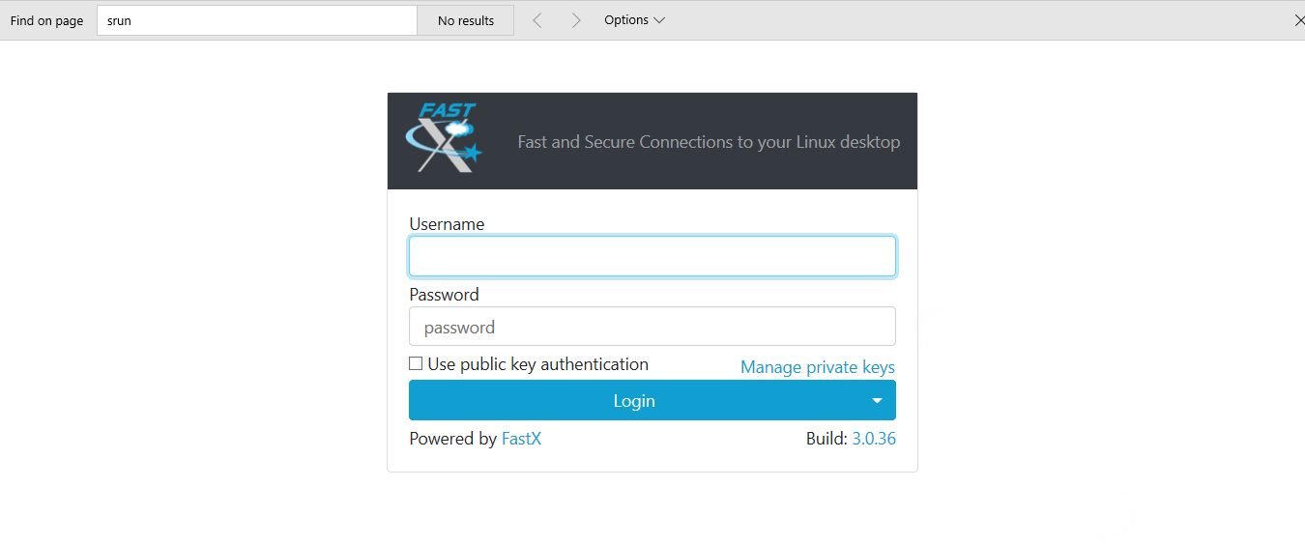
Log in Using Your Netbadge Password

Slide 17
Log in Using Your Netbadge Credentials
If this page does not appear, make sure that you are connected to the UVa VPN..

Slide 18
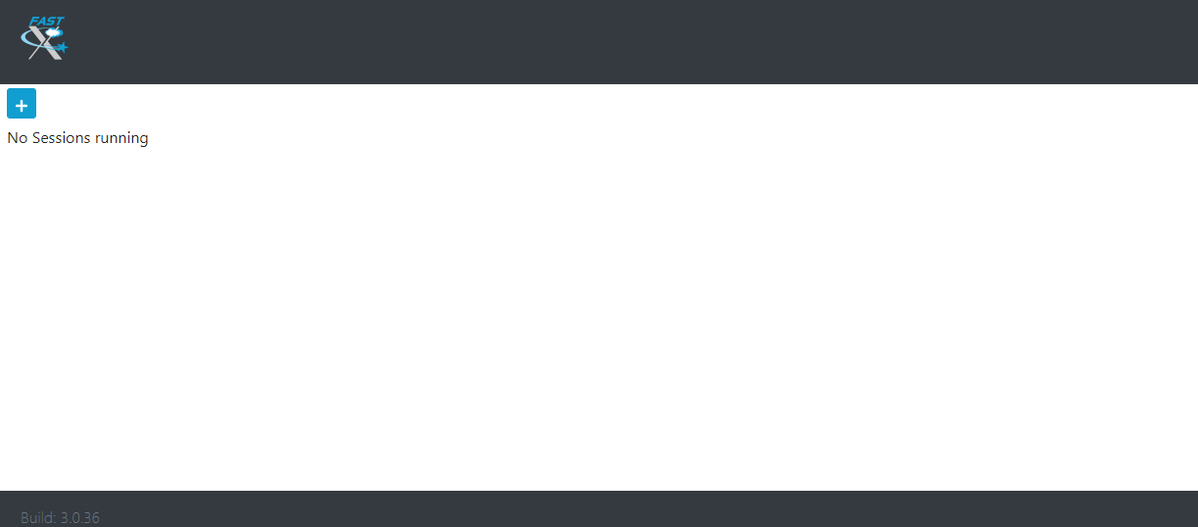
Starting up FastX
Click on the plus sign

Slide 19
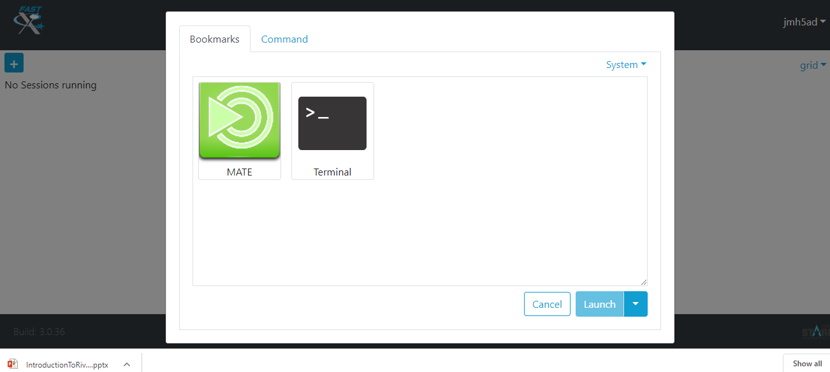
Starting up FastX
Select MATE; Click Launch

Slide 20
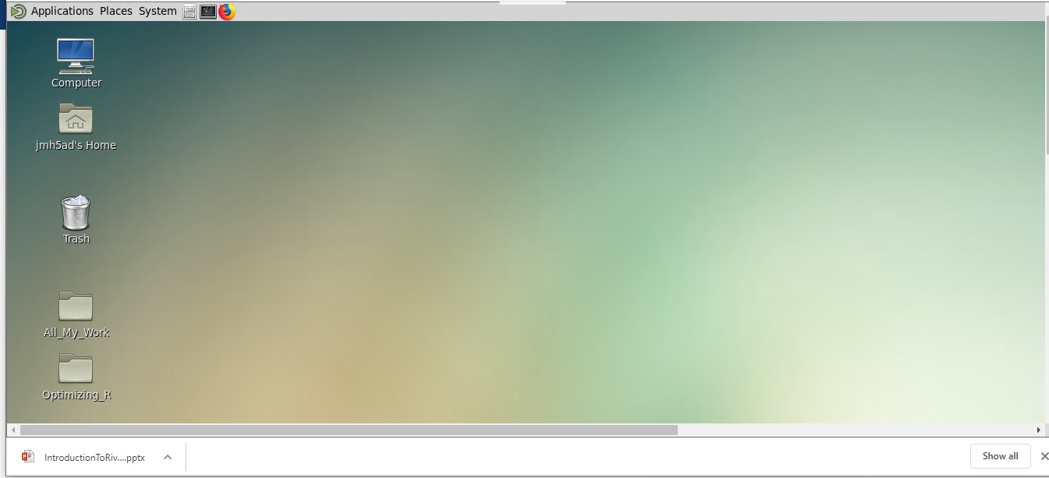
FastX Desktop

Slide 21
Now, let’s see how we can connect with an ssh client.

Slide 22
SSH Clients
You must use the UVa VPN when off-Grounds for ssh access.
Replace mst3k with your user ID.
On a Mac or Linux system, simply open a Terminal application and type
ssh –Y mst3k@rivanna.hpc.virginia.edu
You may also want to install XQuartz on your Mac to use graphical tools on Rivanna.
Several clients are available for Windows.
We recommend MobaXterm (https://mobaxterm.mobatek.net)
Other options include puTTY and SecureCRT.
Web
Open OnDemand offers a non-graphical (text only) shell through the Clusters menu
Clusters->Rivanna Shell Access

Slide 23
SSH Clients
SSH clients mostly use instructions typed at the command prompt.
You will need to become familiar with Linux/Unix commands.
See https://workshops.rc.virginia.edu/lesson/unix-tutorial/ to learn more about Unix/Linux commands.
Some useful Unix/Linux commands:
$ ls
$ pwd
$ cd folder_name
$ cp file_1 file_2
$ rm file_1
$ cd ..

Slide 24
Connecting to the Cluster
The hostname for the Interactive frontends: rivanna.hpc.virginia.edu
(does round-robin among the three front-ends)
However, you also can log onto a specific front-end:
rivanna1.hpc.virginia.edu
rivanna2.hpc.virginia.edu
rivanna3.hpc.virginia.edu

Slide 25
Cluster Environment

Slide 26
After you have logged in . . .
You will be in your home directory.
The home directory on Rivanna has 50GB of storage capacity.
The home directory is for personal use and is not shareable with other users.

Slide 27
Checking your Allocation
To see how many SUs you have available for running jobs, type allocations at the command-line prompt:
$ allocations
Allocations available to Misty S. Theatre (mst3k):
* robot_build: less than 6,917 service-units remaining.
* gizmonic-testing: less than 5,000 service-units remaining.
* crow-lab: less than 2,978 service-units remaining.
* gypsy: no service-units remaining
for more information about a specific allocation, please run:
'allocations -a <allocation name>'

Slide 28
Your /scratch Directory
Each user will have access to 10 TB of temporary storage.
It is located in a subdirectory under /scratch, and named with your userID
e.g., /scratch/mst3k
You are limited to 350,000 files in your scratch directory.
The /scratch directory is for personal use and is not shareable with other users.
Important:
/scratch is NOT permanent storage and files that have not been accessed for more than 90 days will be marked for deletion.

Slide 29
Running Jobs from Scratch
We recommend that you run your jobs out of your /scratch directory for two reasons:
/scratch is on a Lustre filesystem (a storage system designed specifically for parallel access).
/scratch is connected to the compute nodes with Infiniband (a very fast network connection).
We also recommend that
You keep copies of your programs and data in more permanent locations (e.g., your home directory or leased storage).
After your jobs finish, you copy the results to more permanent storage).

Slide 30
Checking your Storage
To see how much disk space you have used in your home and scratch directories, open a Terminal window and type hdquota at the command-line prompt:
$ hdquota
Type Location Name Size Used Avai l Use%
===============================================================================
home /home mst3k 50G 472M 50G 1%
Location Age_Limit(Days) Disk_Limit(GB) Use(GB) File_Limit Use
====================================================================================
/scratch/mst3k 90 10240 0 350000 3

Slide 31
Moving data onto Rivanna
You have several options for transferring data onto your home or /scratch directories.
Use the scp command in a terminal window.
Use a drag-and-drop option with MobaXterm (Windows) or Cyberduck (Mac OS).
For small files, use the Upload and Download buttons in the Open OnDemand Files App.
Use the web browser in the FastX desktop to download data from UVA Box.
Use the git clone command to copy git repositories
Set up a Globus endpoint on your laptop and use the Globus web interface to transfer files.
(See https://www.rc.virginia.edu/userinfo/globus/ for details)

Slide 32
Modules

Slide 33
Modules
Any application software that you want to use will need to be loaded with the module load command.
For example:
module load matlab
module load anaconda/5.2. 0-py3.6
module load gcc R/3.5.1
You will need to load the module any time that you create a new shell
Every time that you log out and back in
Every time that you run a batch job on a compute node

Slide 34
Module Details
module avail – Lists all available modules and versions.
module spider – Shows all available modules
module key keyword – Shows modules with the keyword in the description
module list – Lists modules loaded in your environment.
module load mymod – Loads the default module to set up the environment for some software.
module load mymod/N.M – Loads a specific version N.M of software mymod.
module load <compiler> <mpi> mymod – For compiler- and MPI- specific modules, loads the modules in the appropriate order and, optionally, the version. You will need to provide the actual names instead of <compiler> and <mpi>.
module purge – Clears all modules.

Slide 35
Learning more about a Module
To locate a python module, try the following:
To find bioinformatics software packages, try this:
The available software is also listed on our website:
https://www.rc.virginia.edu/userinfo/rivanna/software/complete-list/
$ module avail python
$ module spider python
$ module key python
$ module key bio

Slide 36
SLURM

Slide 37
SLURM
SLURM is the resource manager on Rivanna.
It manages the hardware resources on the cluster (e.g. compute nodes/cpu cores, compute memory, etc.).
SLURM allows you to request resources within the cluster to run your code.
It is used for submitting jobs to compute nodes from an access point (generally called a frontend).
Frontends are intended for editing, compiling, and very short test runs.
Production jobs go to the compute nodes through the resource manager.
Open OnDemand interactive apps submit to SLURM and run on compute nodes.
SLURM documentation:
https://www.rc.virginia.edu/userinfo/rivanna/slurm/ http://slurm.schedmd.com/documentation.html

Slide 38
Partitions (Queues)
Rivanna has several partitions (or queues) for job submissions.
You will need to specify a partition when you submit a job.
To see the partitions that are available to you, type qlist at the command-line prompt.
$ qlist
Queue Total Free Jobs Jobs Time SU
(partition) Cores Cores Running Pending Limit Charge
=====================================================================
bii 200 180 0 0 7-00:00:00 1
Standard 200 180 0 0 7-00:00:00 1
Dev 200 180 0 0 1:00:00 0
Parallel 200 180 0 0 3-00:00:00 1
largemem 200 180 0 0 4-00:00:00 1
gpu 28 28 0 0 3-00:00:00 3
knl 200 180 0 0 3-00:00:00 1

Slide 39
Compute Node Partitions (aka Queues)
Queue Name | Purpose | Job Time Limit | Memory / Node | Cores / Node
standard | For jobs on a single compute node | 7 days | 256 GB 384 GB | 28 40
gpu | For jobs that can use general purpose graphical processing units (GPGPUs) (K80 or P100) | 3 days | 256 GB | 28
parallel | For large parallel jobs on up to 120 nodes (<= 2400 CPU cores) | 3 days | 128 GB | 20
largmem | For memory intensive jobs (<= 16 cores/node) | 4 days | 1 TB | 16
dev | To run jobs that are quick tests of code | 1 hour | 128 GB | 4

Slide 40
SLURM Scripts
A SLURM script is a bash script with SLURM directives (#SBATCH) and command-line instructions for running your program.
#!/bin/bash
#SBATCH --nodes=1 #total number of nodes for the job
#SBATCH --ntasks=1 #how many copies of code to run
#SBATCH --time=1-12:00:00 #amount of time for the whole job
#SBATCH --partition=standard #the queue/partition to run on
#SBATCH --account=myGroupName #the account/allocation to use
module purge
module load gcc R #load modules that my job needs
Rscript myProg.R #command-line execution of my job

Slide 41
Submitting a SLURM Job
To submit the SLURM command file to the queue, use the sbatch command at the command line prompt.
For example, if the script on the previous slide is in a file named job_script.slurm, we can submit it as follows:
-bash-4.1$ sbatch job_script.slurm
Submitted batch job 18316

Slide 42
Checking Job Status
To display the status of only your active jobs, type:
squeue –u <your_user_id>
-bash-4.2$ squeue –u mst3k
JOBID PARTITION NAME USER ST TIME NODES NODELIST(REASON)
standard job_sci mst3k R 1:45 1 udc-aw38-34-l
The squeue command will show pending jobs and running jobs, but not failed, canceled or completed job.

Slide 43
Checking Job Status
To display the status of all jobs, type:
sacct –S <start_date>
-bash-4.2$ sacct –S 2019-01-29
3104009 RAxML_NoC+ standard hpc_build 20 COMPLETED 0:0
3104009.bat+ batch hpc_build 20 COMPLETED 0:0
3104009.0 raxmlHPC-+ hpc_build 20 COMPLETED 0:0
3108537 sys/dashb+ gpu hpc_build 1 CANCELLED+ 0:0
3108537.bat+ batch hpc_build 1 CANCELLED 0:15
3108562 sys/dashb+ gpu hpc_build 1 TIMEOUT 0:0
3108562.bat+ batch hpc_build 1 CANCELLED 0:15
3109392 sys/dashb+ gpu hpc_build 1 TIMEOUT 0:0
3109392.bat+ batch hpc_build 1 CANCELLED 0:15
3112064 srun gpu hpc_build 1 FAILED 1:0
3112064.0 bash hpc_build 1 FAILED 1:0
The sacct command lists all jobs (pending, running, completed, canceled, failed, etc.) since the specified date.

Slide 44
Canceling a Job
To delete a job from the queue, use the scancel command with the job ID number at the command line prompt:
To cancel all your jobs, run this command:
-bash-4.2$ scancel 18316
-bash-4.2$ scancel –u $USER

Slide 45
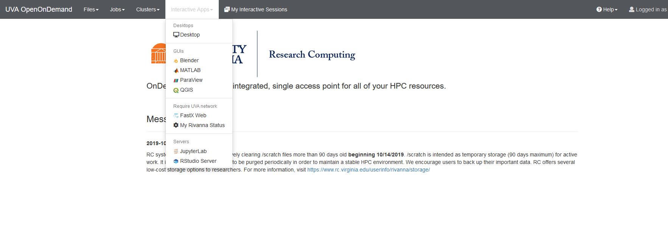
Open OnDemand Apps
A selection of graphically-oriented applications is available through Open OnDemand

Slide 46
Submitting an Interactive App
Click the application you wish to run. A form appears for you to fill out SLURM parameters.
Keep in mind that OOD apps run on compute nodes and charge SUs, including the Desktop app. FastX runs on a frontend and does not charge SUs but does limit what you can do.
After filling out the form to specify time, partition, and other relevant requests, click Launch.
The job request will be entered into the partition. When it starts click Launch <App>

Slide 47
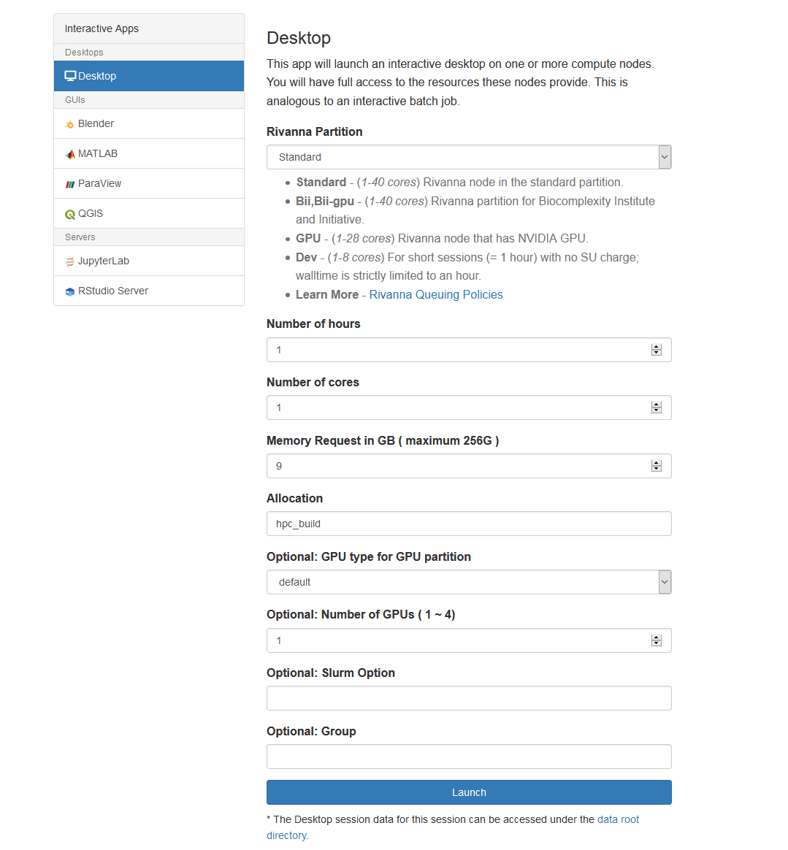

Slide 48
Terminate Your Session
When you have finished, terminate your work
For example, if running the Desktop go to the System -> Log out menu
Return to your My Interactive Apps tab and Delete the session
Otherwise it will continue to charge until your time limit is reached.

Slide 49
Need help?
Research Computing Zoom Office Hours
Tuesdays: 3 pm – 5 pm
Wednesdays: 3 pm – 5 pm
Thursdays: 10 am – noon
To connect to the Zoom sessions, go to https://www.rc.virginia.edu/support/#office-hours and click on the “Join us via Zoom” button
Or, contact us through the forms at:
https://www.rc.virginia.edu/support/

